Slide 1
Secured Identity Management Using Single Sign-on (SSO) in Private Cloud
Presentation by
Namrata Avhad D12A/03
Sonal Belani D12A/05
Gautam Dinga D12A/14

Slide 2
Introduction
Single sign-on (SSO) is a session and user authentication service that permits a user to use one set of login credentials -- for example, a username and password -- to access multiple applications. With SSO end-user's time and efforts get minimized as they don't need to constantly sign in and out separately into a variety of web, on-premises, and cloud apps.
Single sign-on (SSO) is a mechanism that allows users to authenticate once and gain access to multiple applications without having to enter login credentials repeatedly. In a private cloud environment, SSO can be implemented using various protocols such as Security Assertion Markup Language (SAML), OpenID Connect (OIDC), and OAuth2.0. These protocols enable secure exchange of authentication and authorization data between different applications and services, allowing users to access them seamlessly without having to enter their credentials multiple times.
SSO helps to reduce the risk of password-related security breaches because users only need to remember one set of credentials, which are securely stored by the identity provider (IdP).

Slide 3
Problem Defination
In a private cloud environment, where multiple machines are involved, managing user identities and access to various applications and services can be a complex and time-consuming task. This complexity is compounded by the need for security and privacy of user data, which must be protected against unauthorized access . If there are multiple applications or services with different authentication mechanisms, SSO provides a unified authentication system that enables users to access all the applications with a single set of login credentials. The system should ensure the security of user credentials and provide a seamless user experience by minimizing the need for users to enter their credentials repeatedly .

Slide 4
Lacuna in the Existing System
Security vulnerabilities : Any system that handles sensitive data like user identities and login credentials is a potential target for cyber attacks. In the case of SSO systems in private clouds, there may be vulnerabilities in the software or hardware that could be exploited by attackers.
Complexity : SSO systems can be complex to set up and manage, particularly in private cloud environments with multiple machines. There may be compatibility issues between different components of the system, or difficulties integrating with existing IT infrastructure.
Scalability : As the number of users and machines in the private cloud increases, the SSO system may struggle to keep up with demand. This could result in slow response times, authentication failures, or other issues.
Lack of standardisation : There are multiple standards and protocols for SSO, including SAML, OpenID Connect, and OAuth. Different systems may use different standards, which can lead to compatibility issues and complexity in managing the system.
Lack of user awareness : SSO systems can be opaque to end users, who may not fully understand how their identities are being managed and secured. This can lead to complacency or misunderstandings that could compromise security.

Slide 5
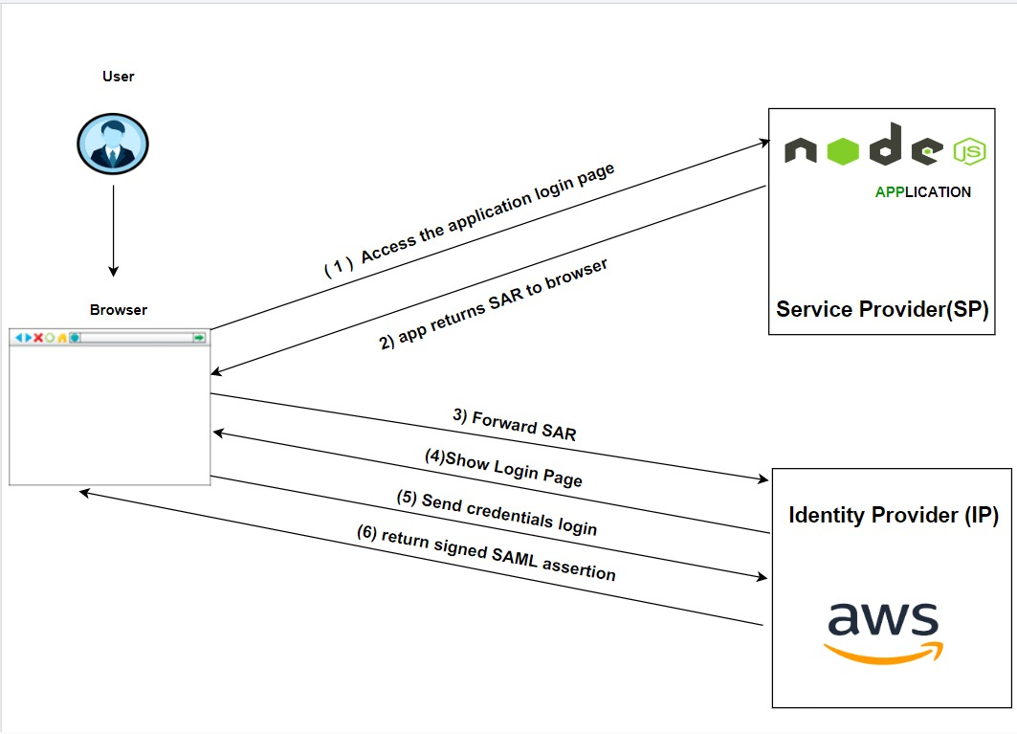
Architectural Diagram

Slide 6
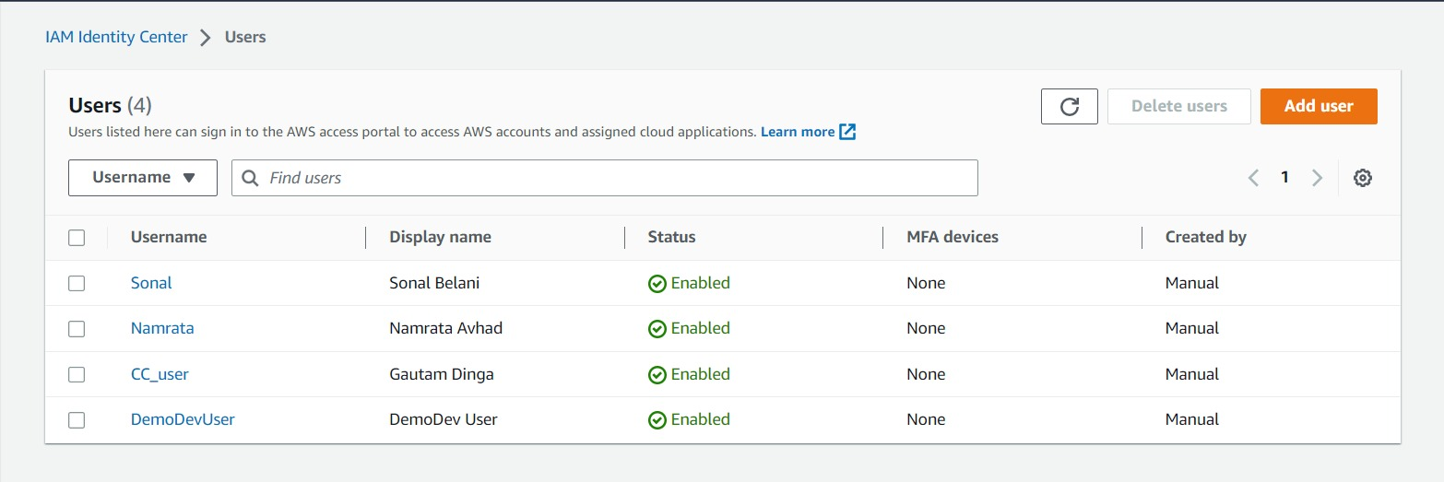
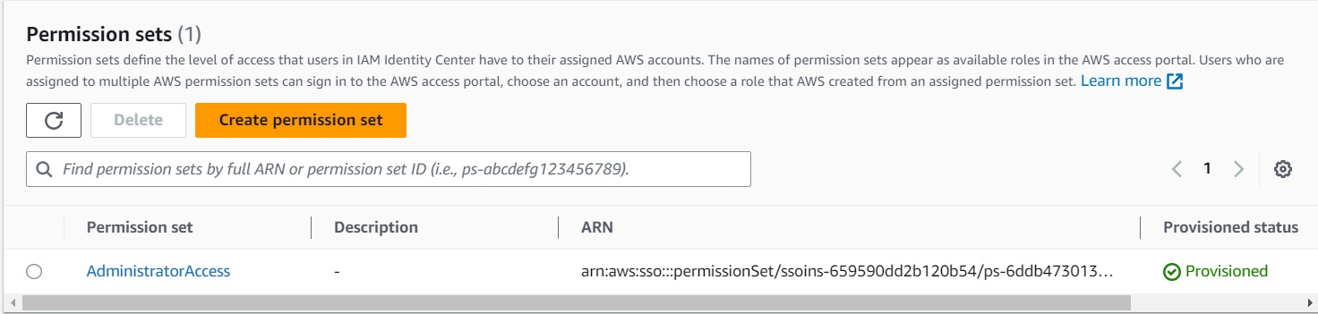
Implementation

Slide 7
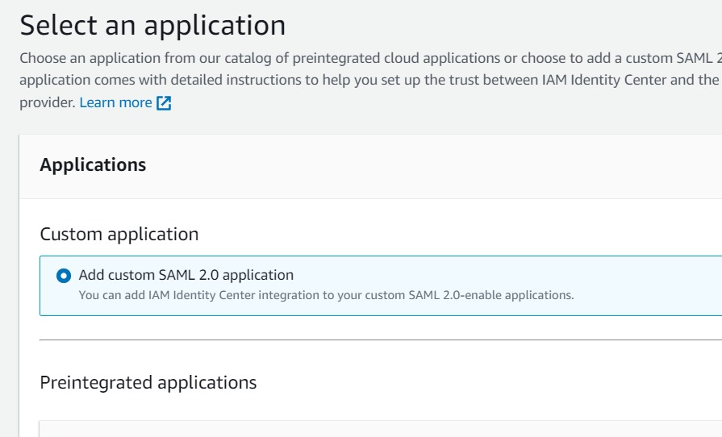
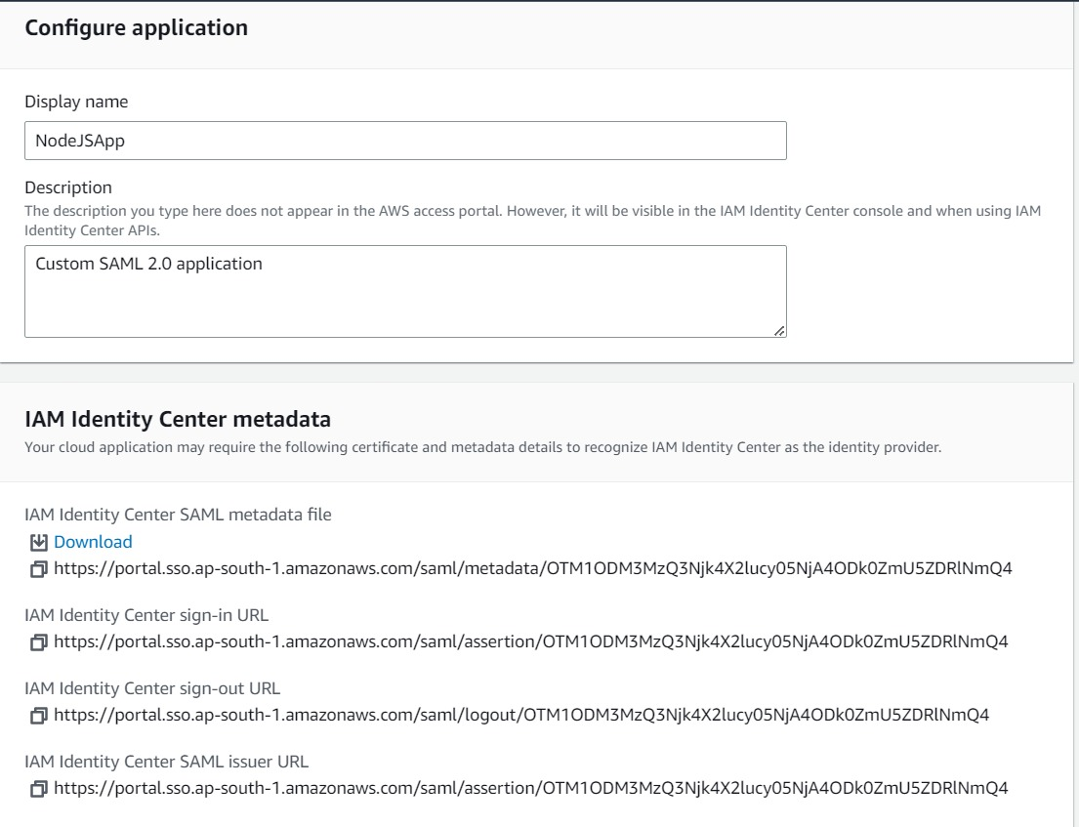

Slide 8
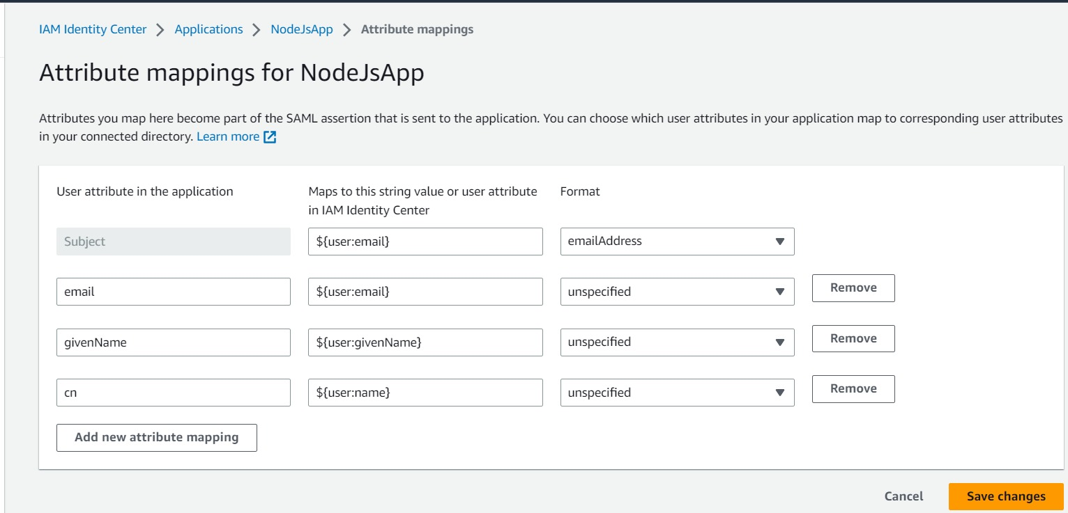
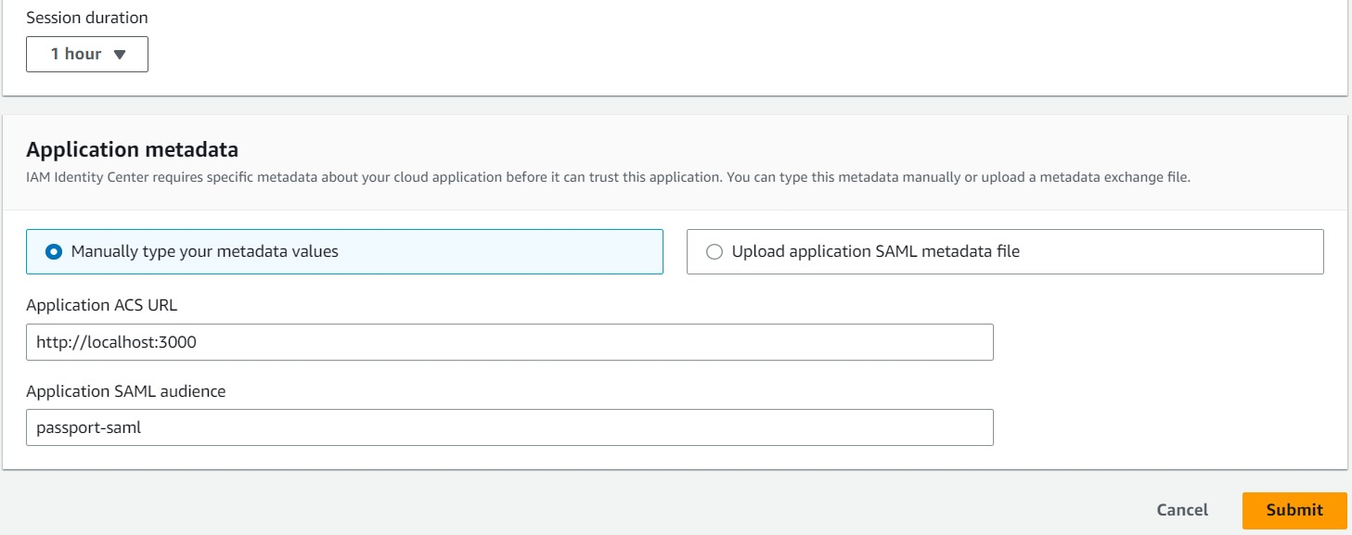

Slide 9
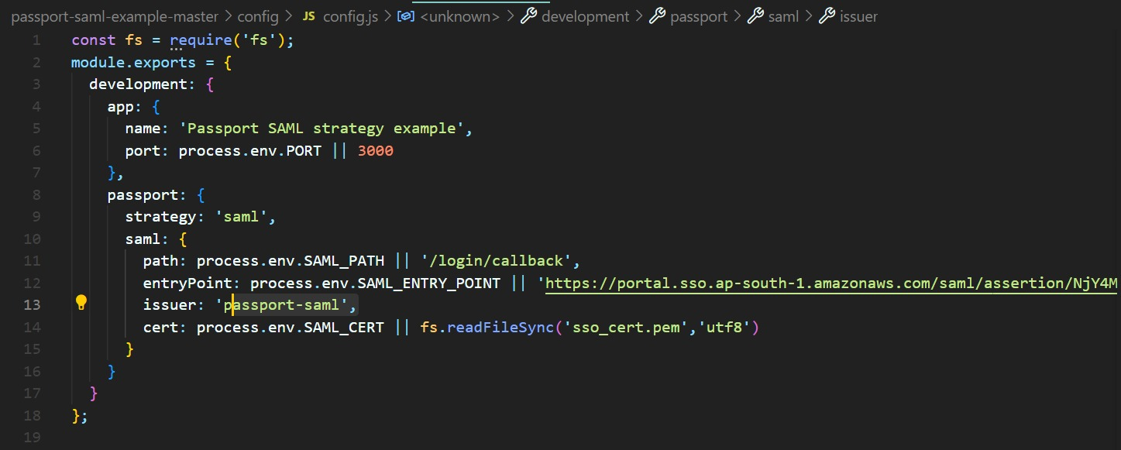
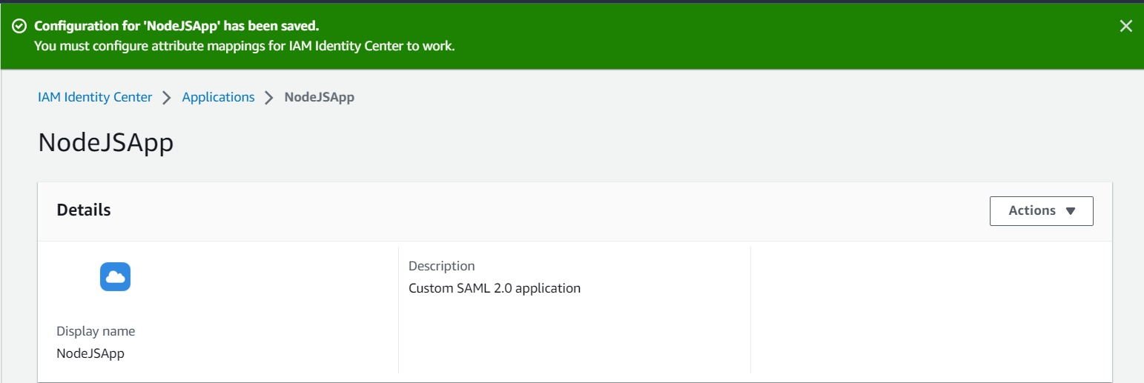

Slide 10
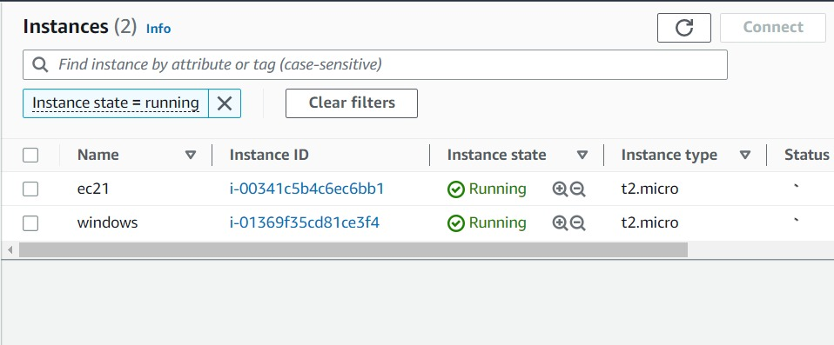

Slide 11
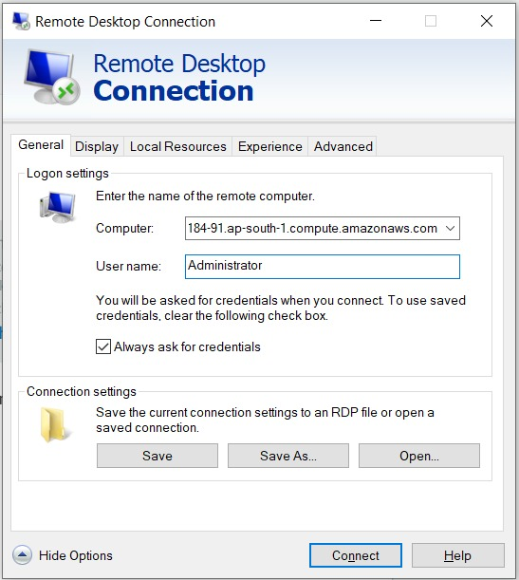
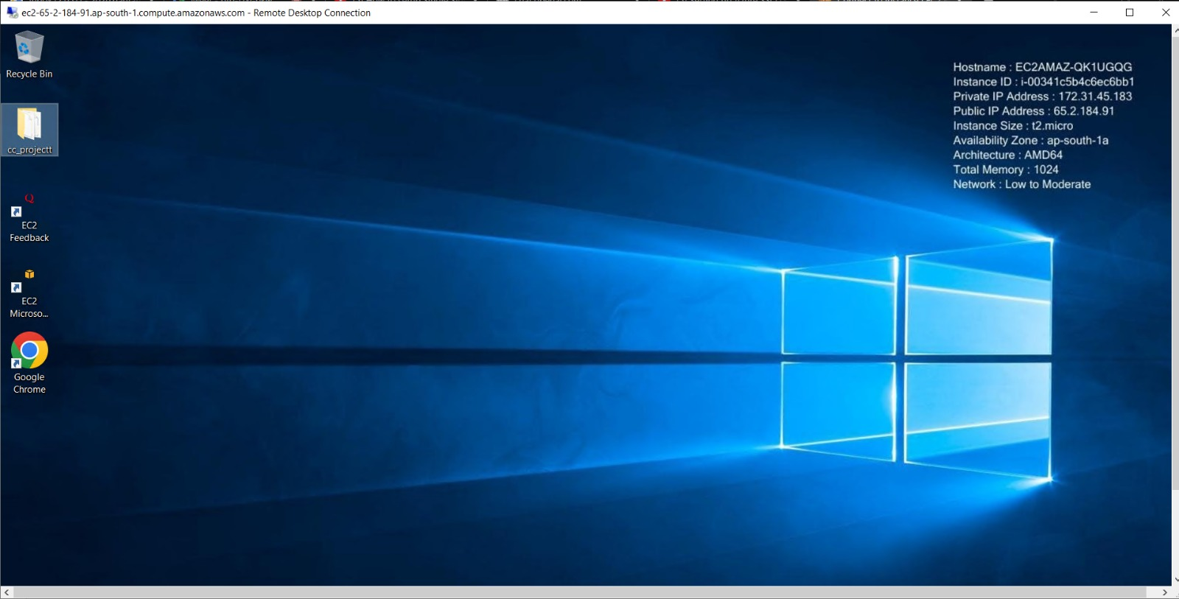

Slide 12
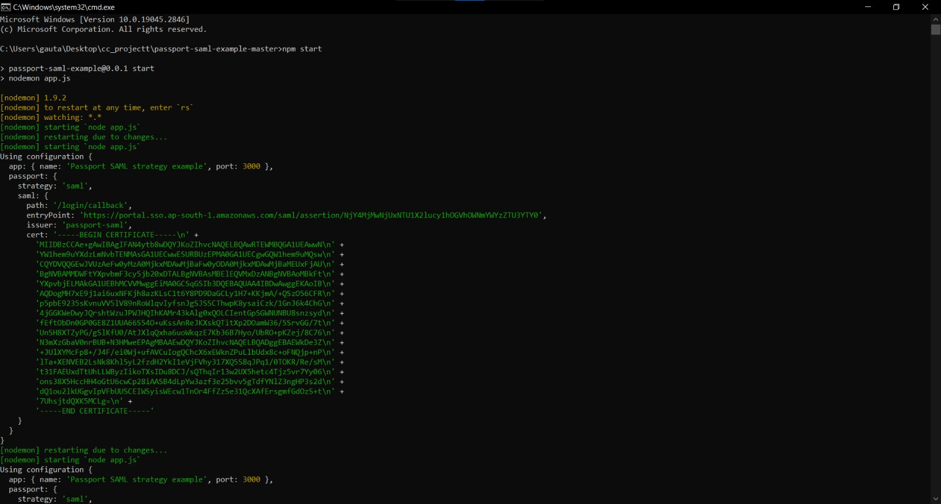
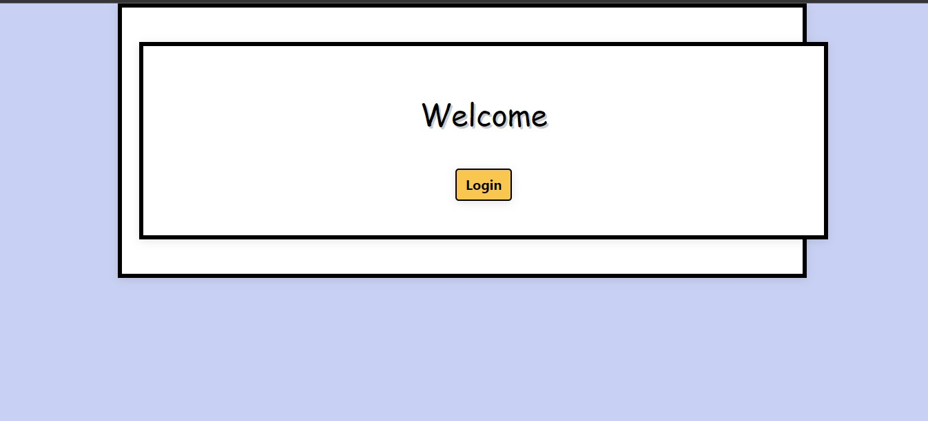

Slide 13
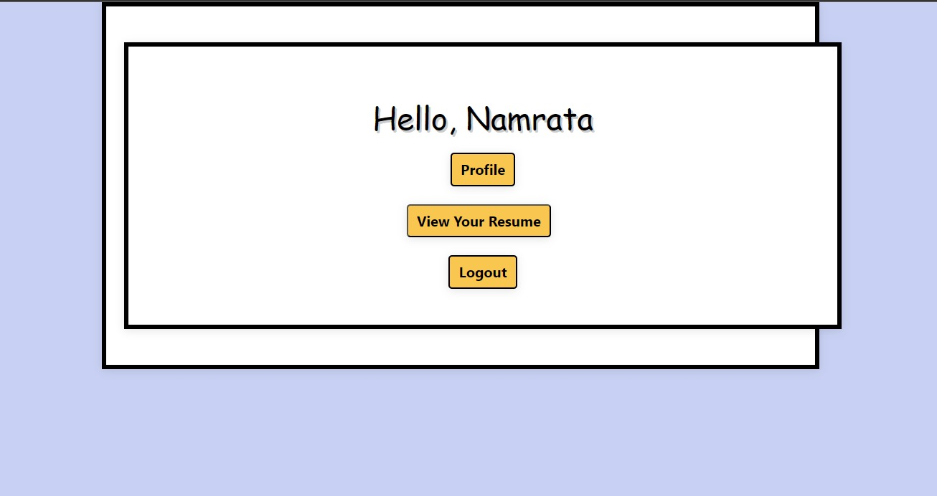
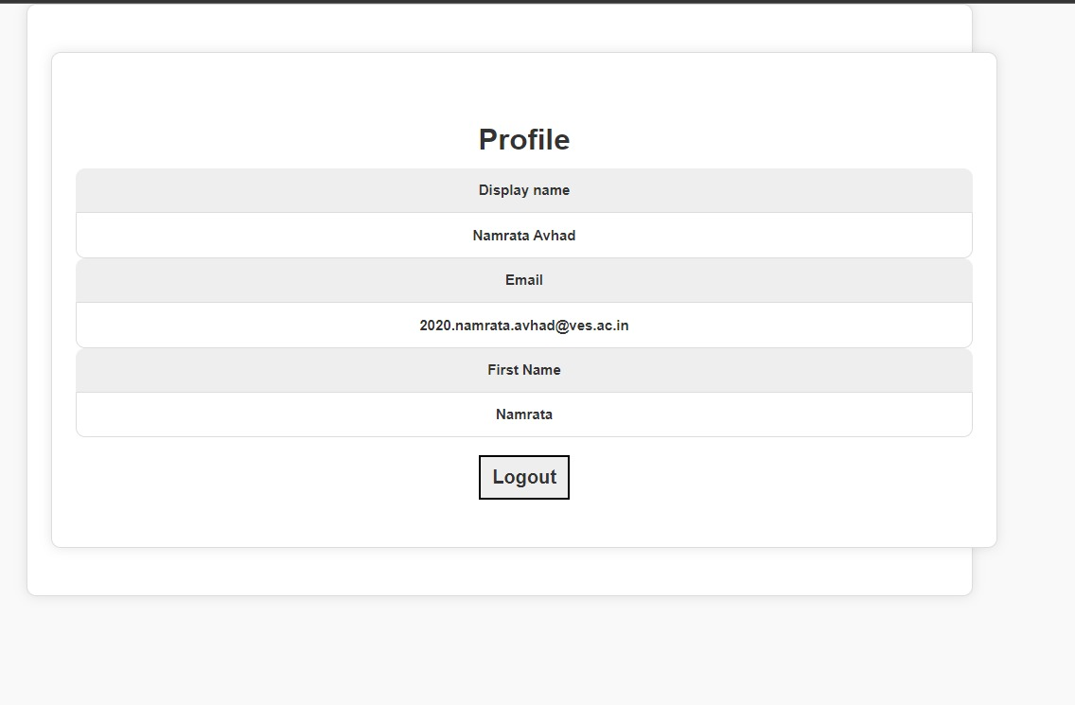

Slide 14
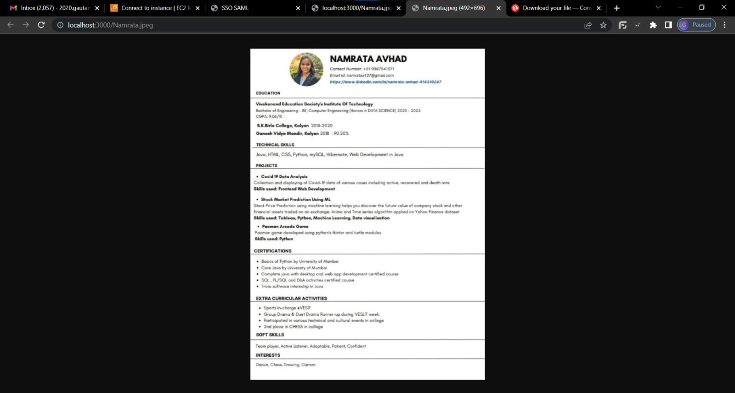

Slide 15
Conclusion
Single Sign-On is an important mechanism for providing a seamless user experience while maintaining the security of user credentials. It allows users to access multiple applications and services with a single set of login credentials, reducing the need for users to remember multiple passwords and enter them repeatedly.
Implementing SSO can provide significant benefits, including improved user experience, increased productivity, and reduced risk of security breaches. However, it requires careful planning, design, and implementation, and organizations need to ensure that they comply with relevant security standards and regulations to protect user data.

Slide 16
References
https://www.ijrti.org/papers/IJRTI2208034.pdf
Secured Identity Management using Single Sign-On in Private Cloud
Abbas, H., Maennel, O., & Assar, S. “Security and privacy issues in cloud computing” , Annals of Telecommunications
Bhardwaj, A., Subrahmanyam, G. V. B., Avasthi, V., & Sastry, H., “Security Algorithms for Cloud Computing”, Procedia Computer Science
https://ieeexplore.ieee.org/document/6168044
Single sign-on and single log out in identity

